Slide 1
Abundance, evenness and richness with IBR
{N_{obs}, S_{obs}}
Species richness (S)
{N = 1, S = 1}
Total number of individuals (N)
Hurlbert 1971 Ecology, Olszewski 2004 OIKOS

Slide 2
Abundance, evenness and richness with IBR
{N_{obs}, S_{obs}}
Species richness (S)
Probability of Interspecific Encounter (PIE)
{N = 1, S = 1}
Total number of individuals (N)
Hurlbert 1971 Ecology, Olszewski 2004 OIKOS

Slide 3
Abundance, evenness and richness with IBR
Rarefied richness (S_{n}): expected species richness
for n individuals
{N_{obs}, S_{obs}}
{N = n, S_{n}}
Species richness (S)
{N = 1, S = 1}
Total number of individuals (N)
Hurlbert 1971 Ecology, Olszewski 2004 OIKOS

Slide 4
Abundance, evenness and richness change with IBR
∆S_{n}: expected # species (for n individuals)
∆S : number of species
∆N: number of individuals
Species richness (S)
∆ S_{PIE}: evenness of species‘ relative abundances
Hurlbert 1971 Ecology, Gotelli & Colwell 2001 Ecol Lett,
Chase et al. 2018 Ecol Lett
Total number of individuals (N)

Slide 5
Abundance, evenness and richness change with IBR
∆S_{n}: expected # species (for n individuals)
∆S : number of species
∆N: number of individuals
Species richness (S)
∆S
∆S
∆S
∆N
∆S_{n}
∆S_{PIE}
∆ S_{PIE}: evenness of species‘ relative abundances
Hurlbert 1971 Ecology, Gotelli & Colwell 2001 Ecol Lett,
Chase et al. 2018 Ecol Lett
Total number of individuals (N)

Slide 6
How can the components change?
S
Altered numbers of individuals (N)
N
∆ S
∆ S
∆ S
∆ N
∆ S_{n}
∆ S_{PIE}

Slide 7
How can the components change?
S
S
Altered numbers of individuals (N)
Species’ relative abundances change
N
N
∆ S
∆ S
∆ S
∆ N
∆ S_{n}
∆ S_{PIE}

Slide 8
How can the components change?
S
S
Rare species only
Altered numbers of individuals (N)
Species’ relative abundances change
N
N
∆ S
∆ S
∆ S
∆ N
∆ S_{n}
∆ S_{PIE}

Slide 9
How can the components change?
S
S
S
Both N and species’ relative abundances change
Altered numbers of individuals (N)
Species’ relative abundances change
N
N
N
∆ S
∆ S
∆ S
∆ N
∆ S_{n}
∆ S_{PIE}

Slide 10
How can the components change?
S
S
S
Both N and species’ relative abundances change
Altered numbers of individuals (N)
Species’ relative abundances change
N
N
N
∆ S
∆ S
∆ S
∆ N
∆ S_{n}
∆ S_{PIE}
S
N
Countervailing N & SAD changes

Slide 11
How can the components change?
S
S
S
Both N and species’ relative abundances change
Altered numbers of individuals (N)
Species’ relative abundances change
N
N
N
∆ S
∆ S
∆ S
∆ N
∆ S_{n}
∆ S_{PIE}
Many of degrees of freedom!
S
S
N
N
Countervailing N & SAD changes

Slide 12
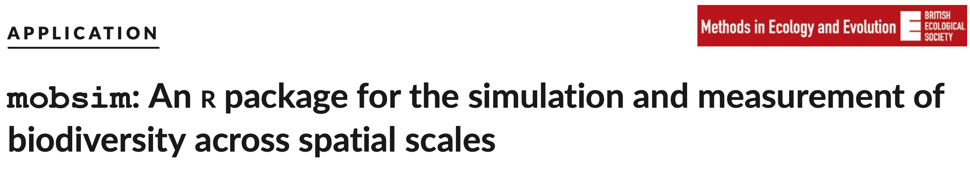
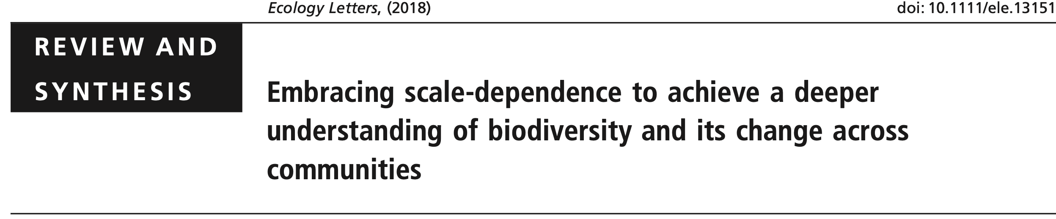

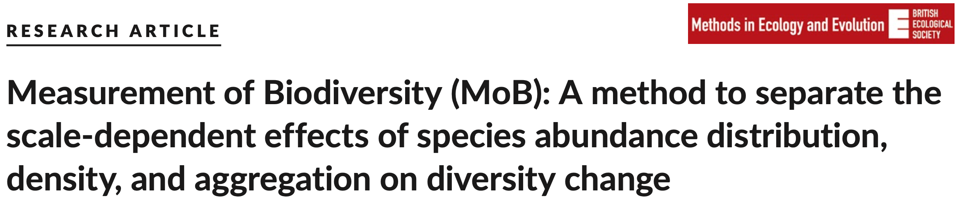
Calculating rarefaction curves, abundance, evenness and richness in R

